Slide 1


Slide 2
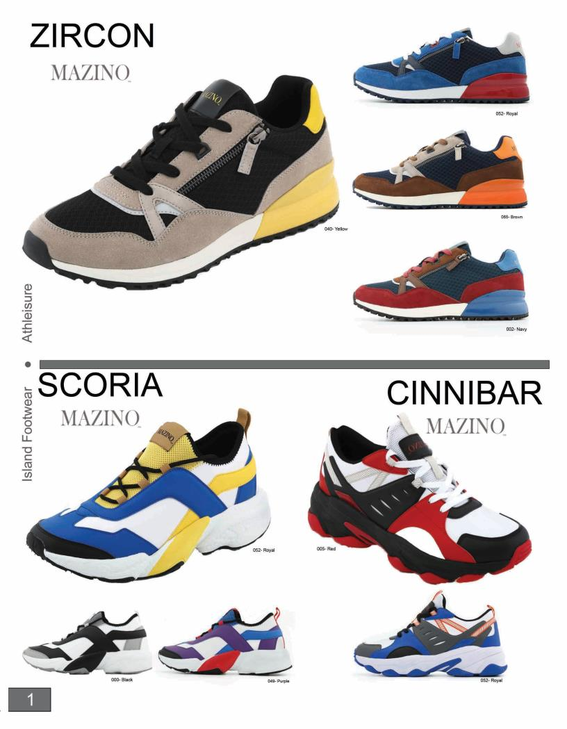

Slide 3
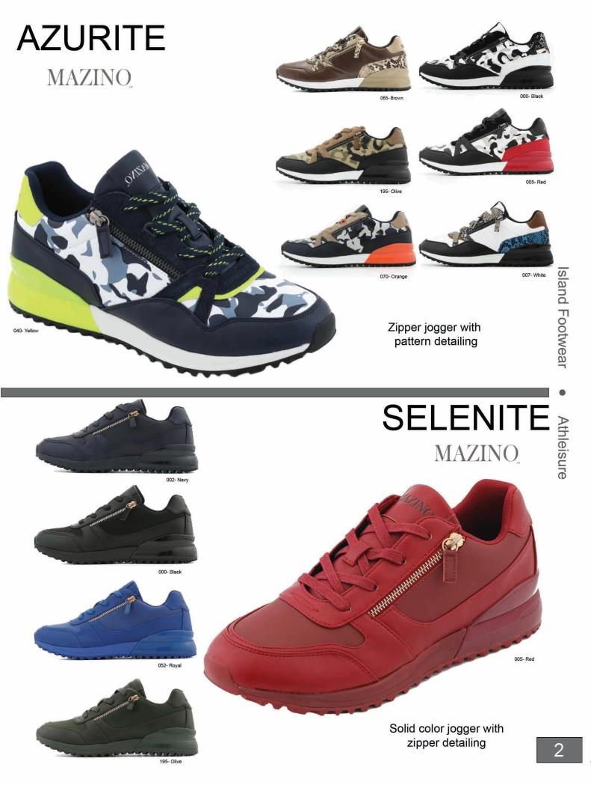

Slide 4
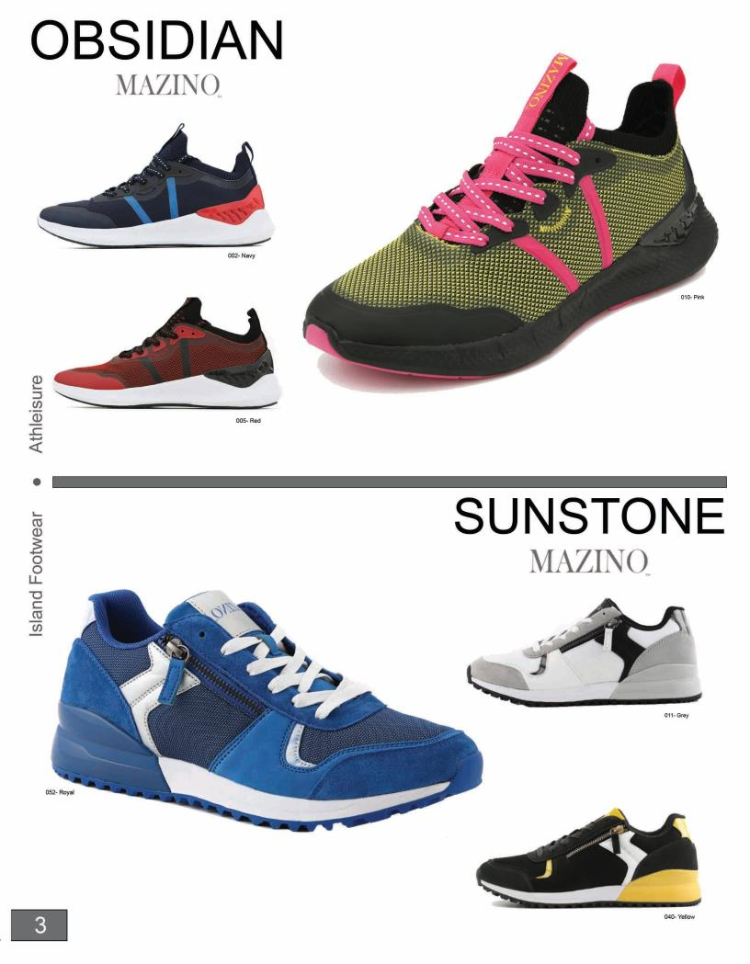

Slide 5
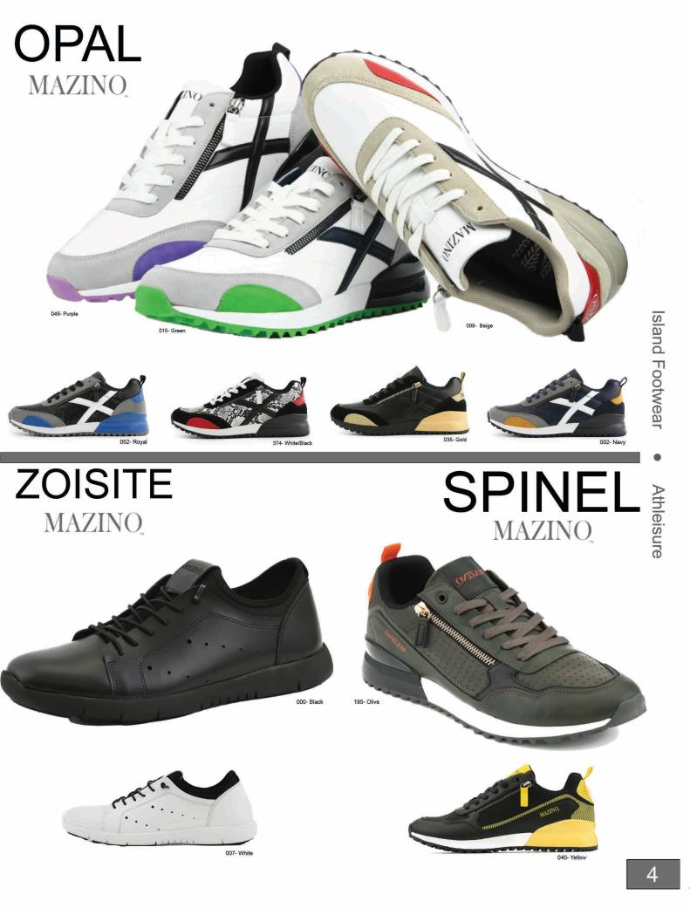

Slide 6
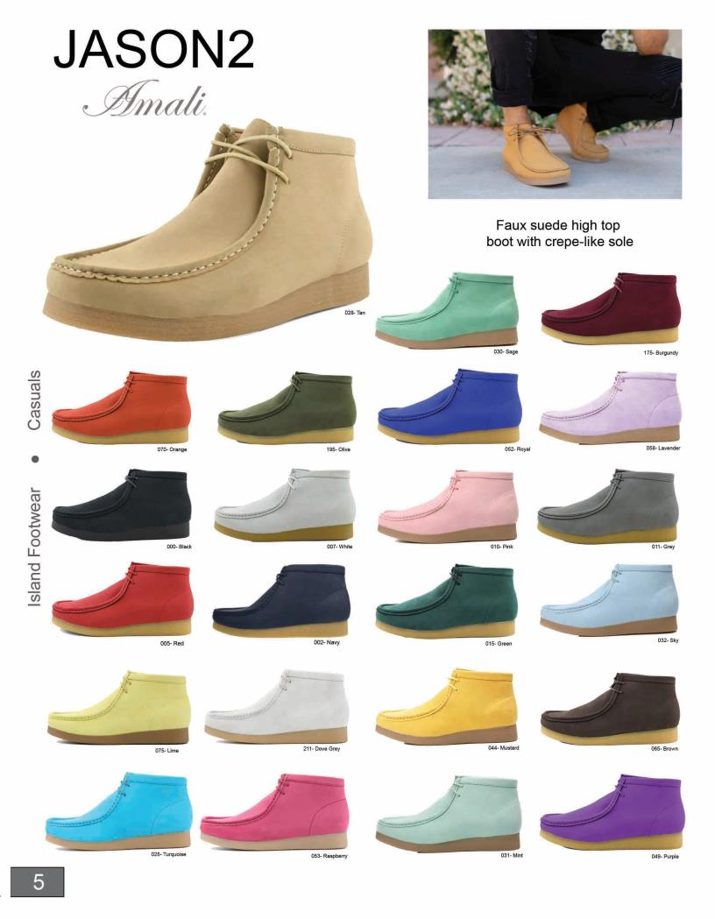

Slide 7
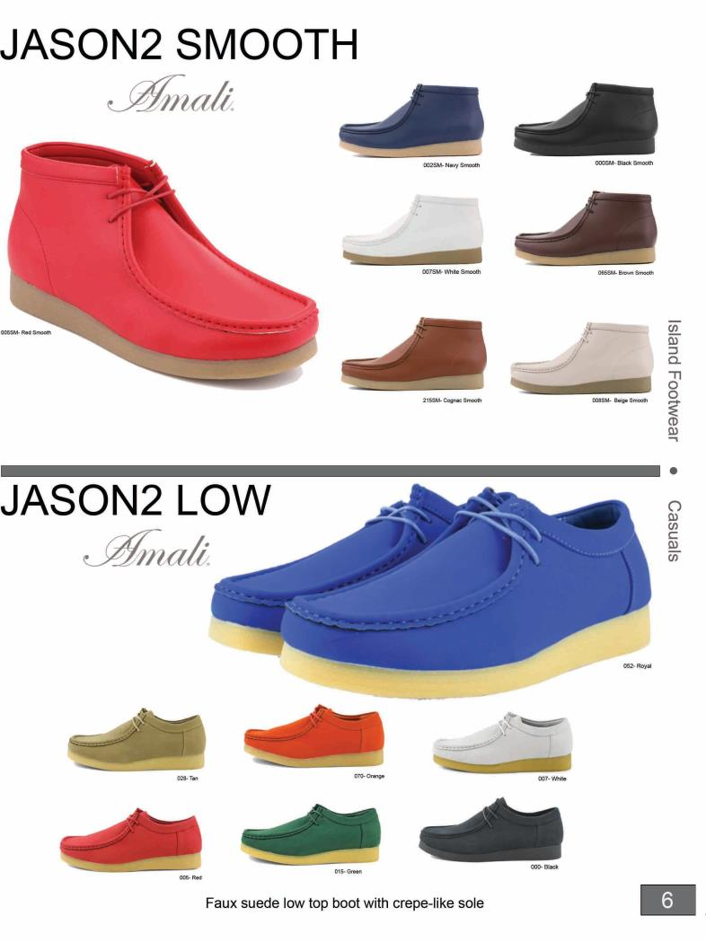

Slide 8
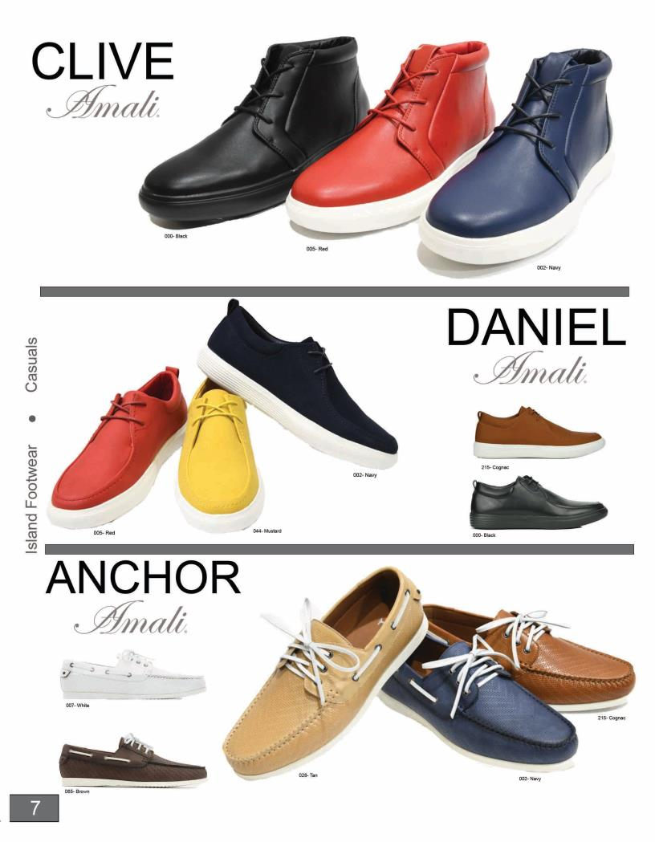

Slide 9
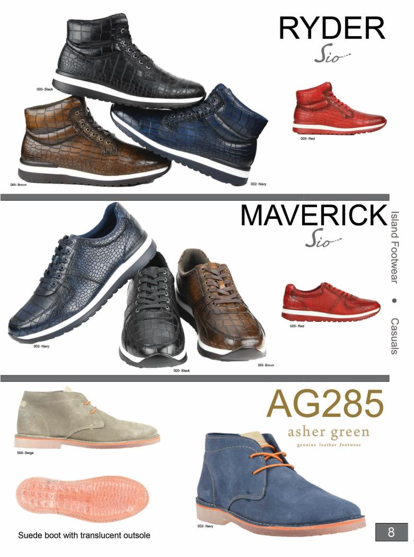

Slide 10
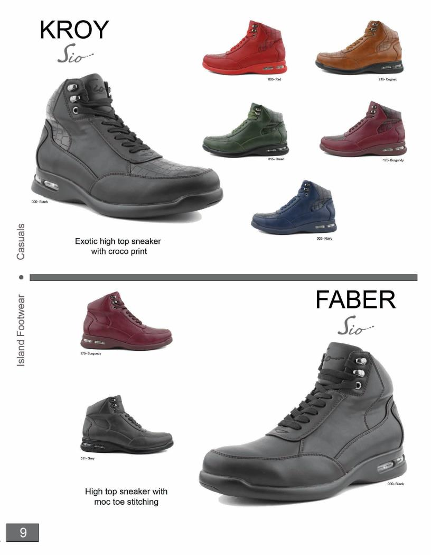

Slide 11
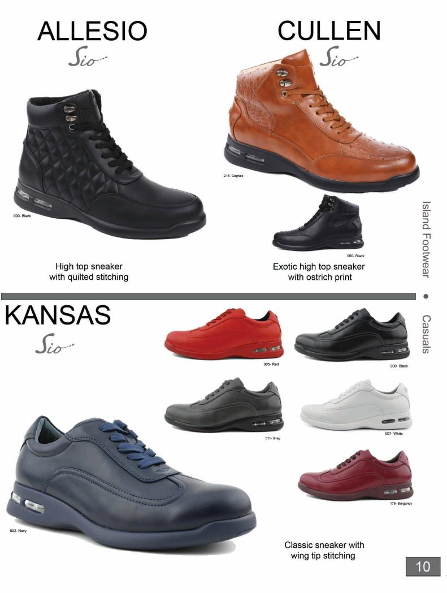

Slide 12
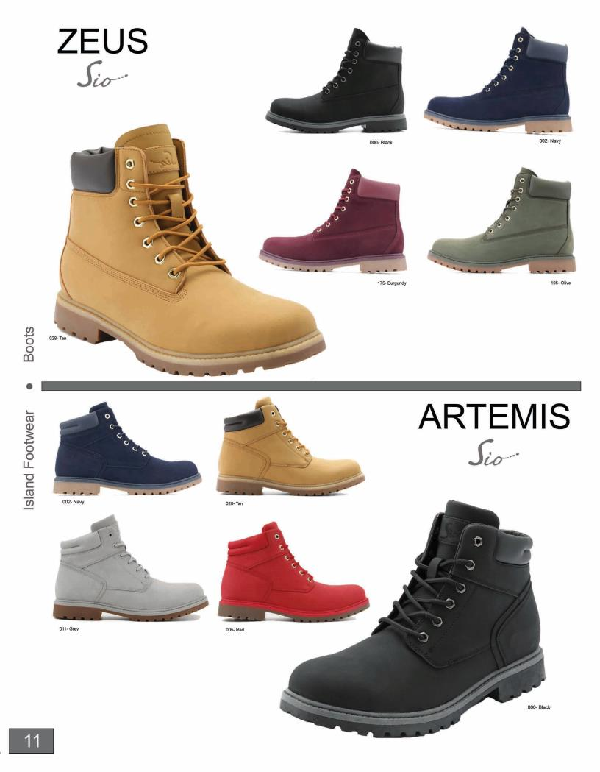

Slide 13
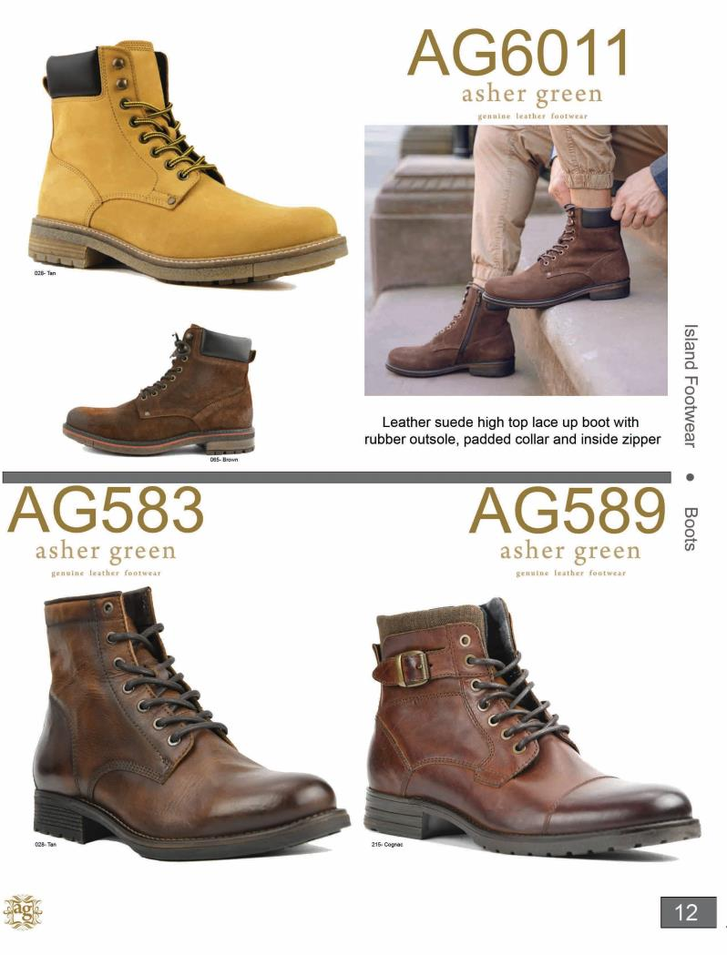

Slide 14
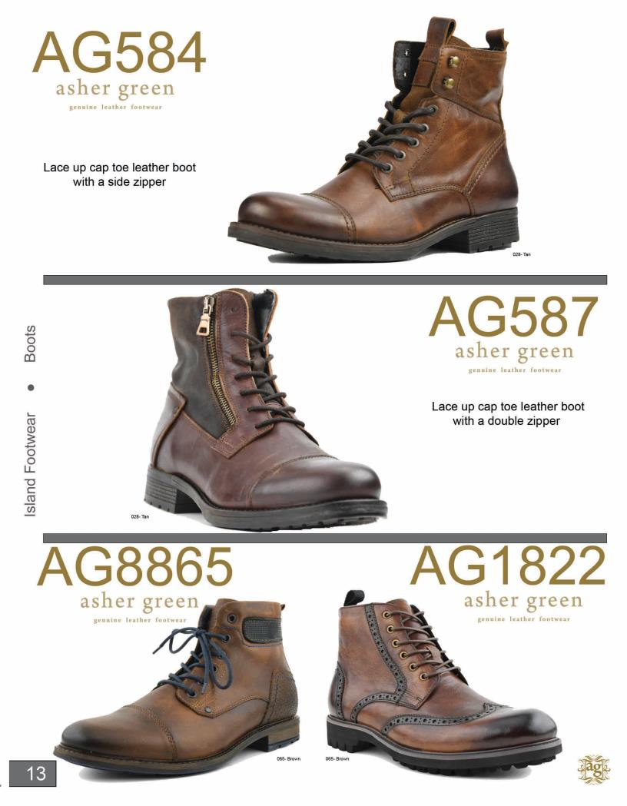

Slide 15
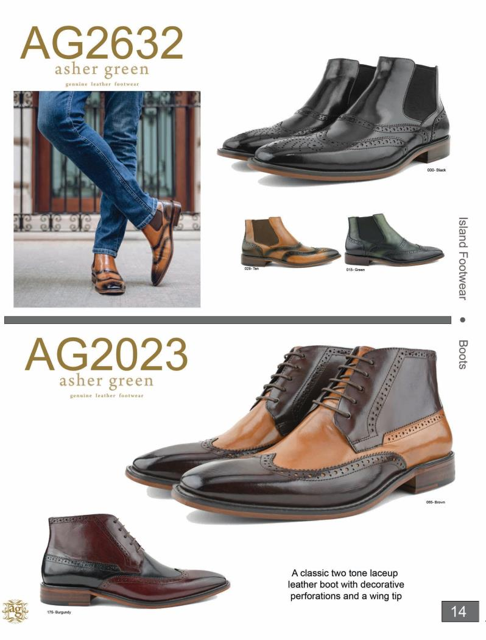

Slide 16
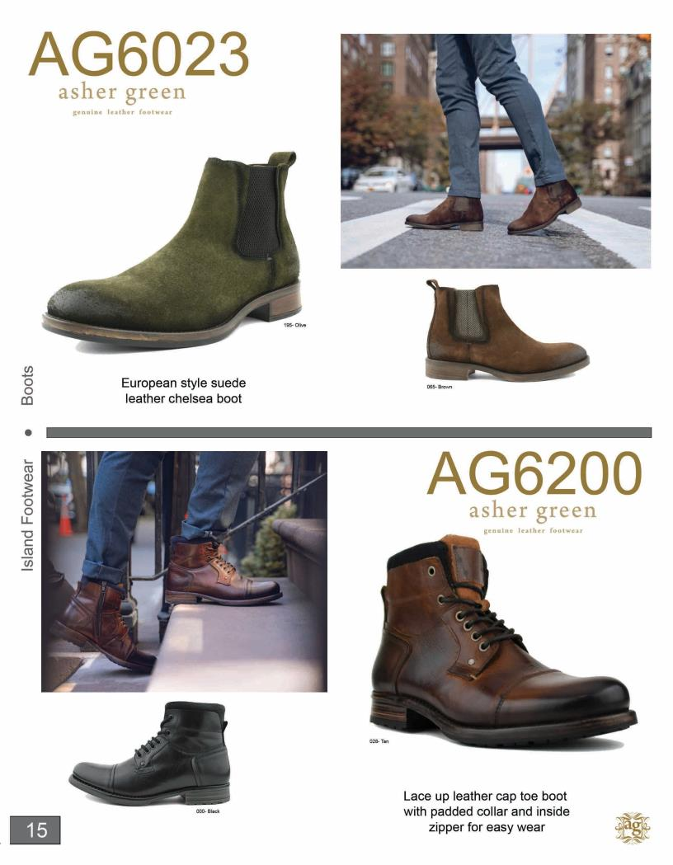

Slide 17
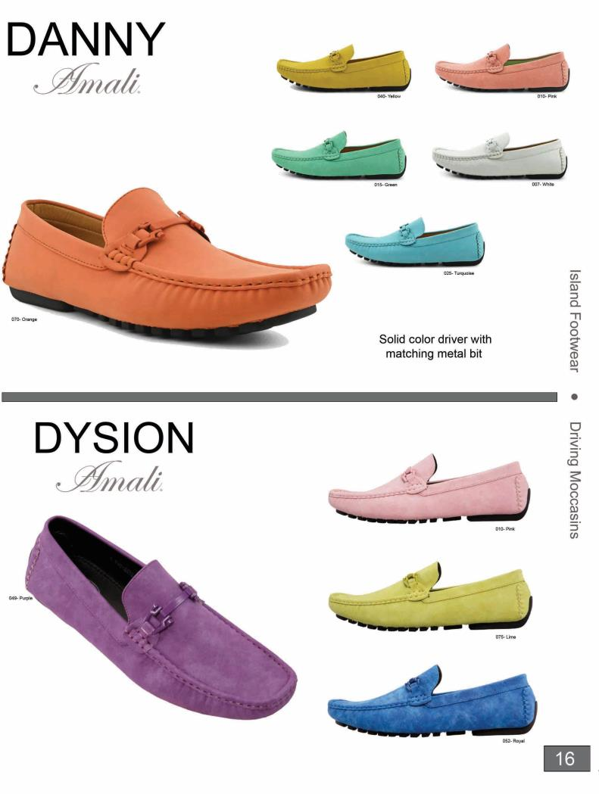

Slide 18
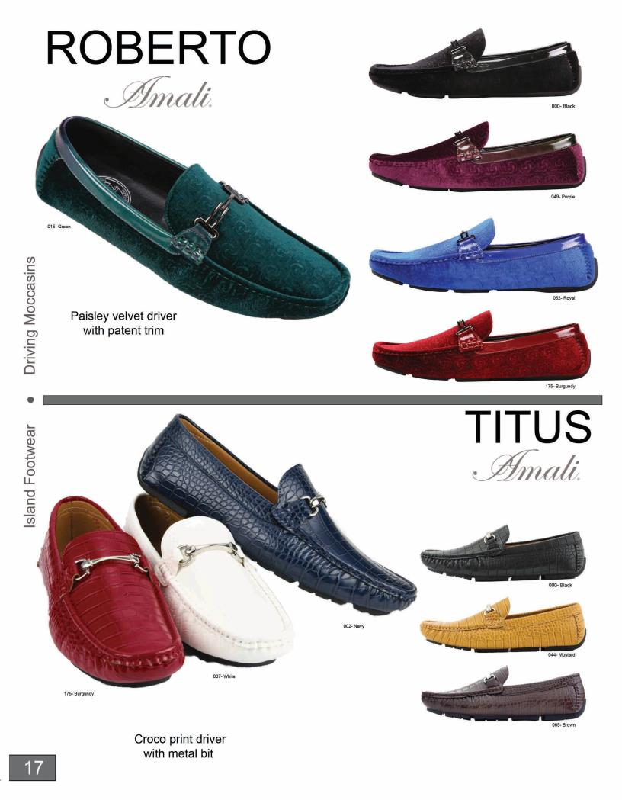

Slide 19
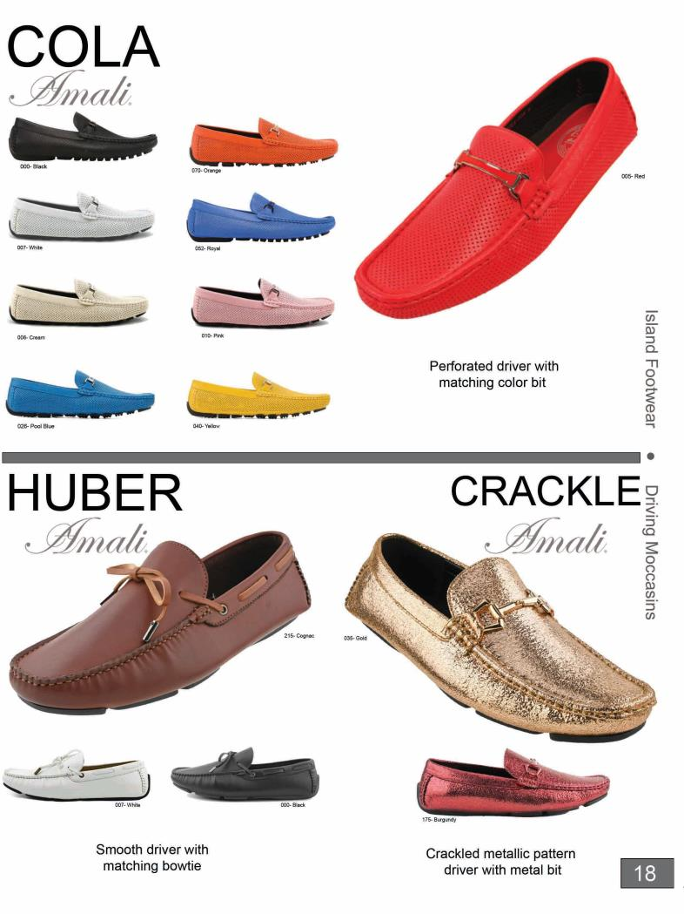

Slide 20
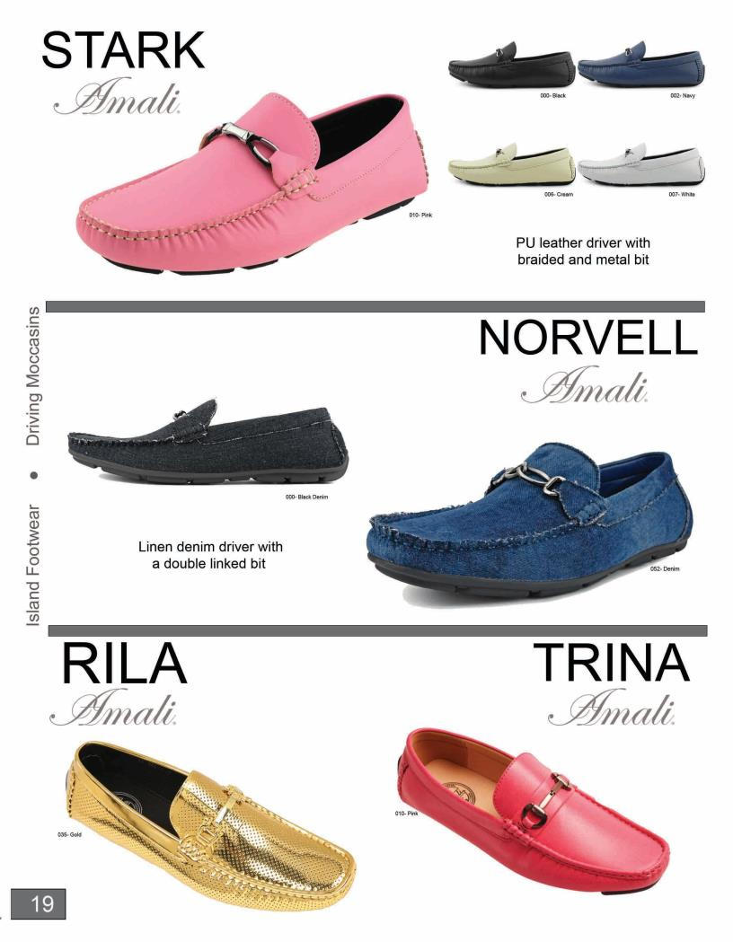

Slide 21
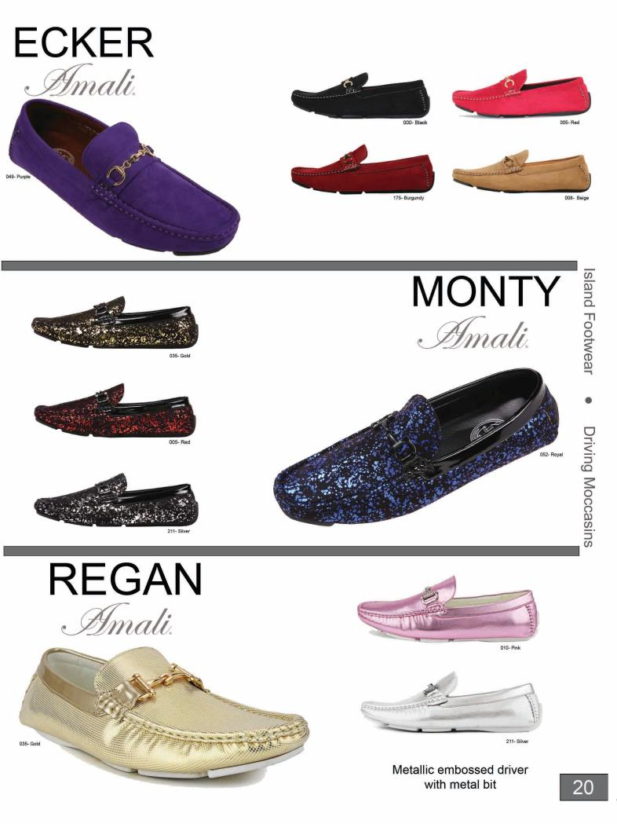

Slide 22
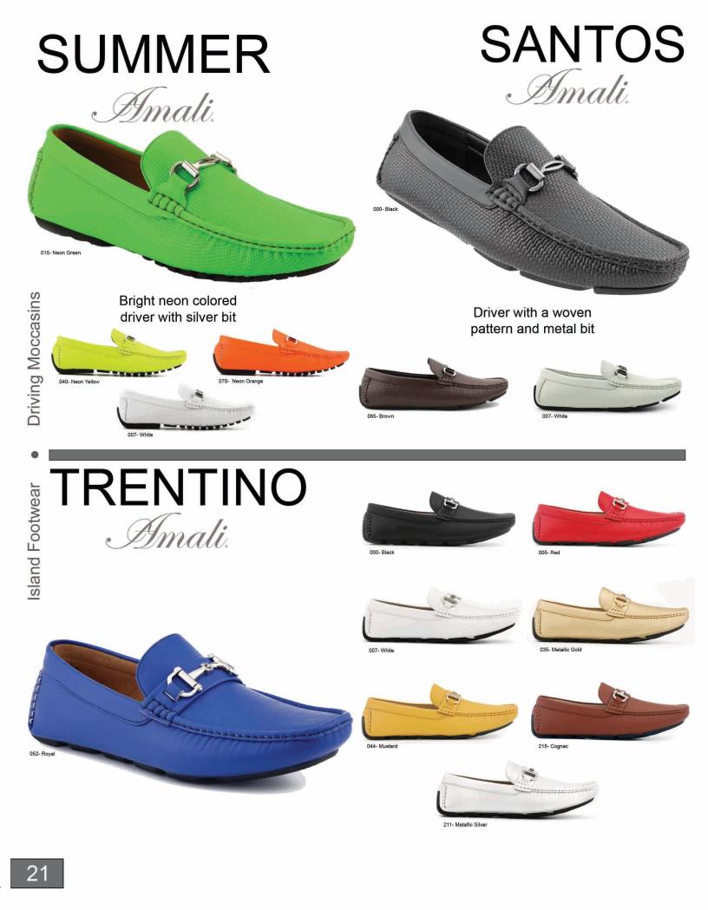

Slide 23
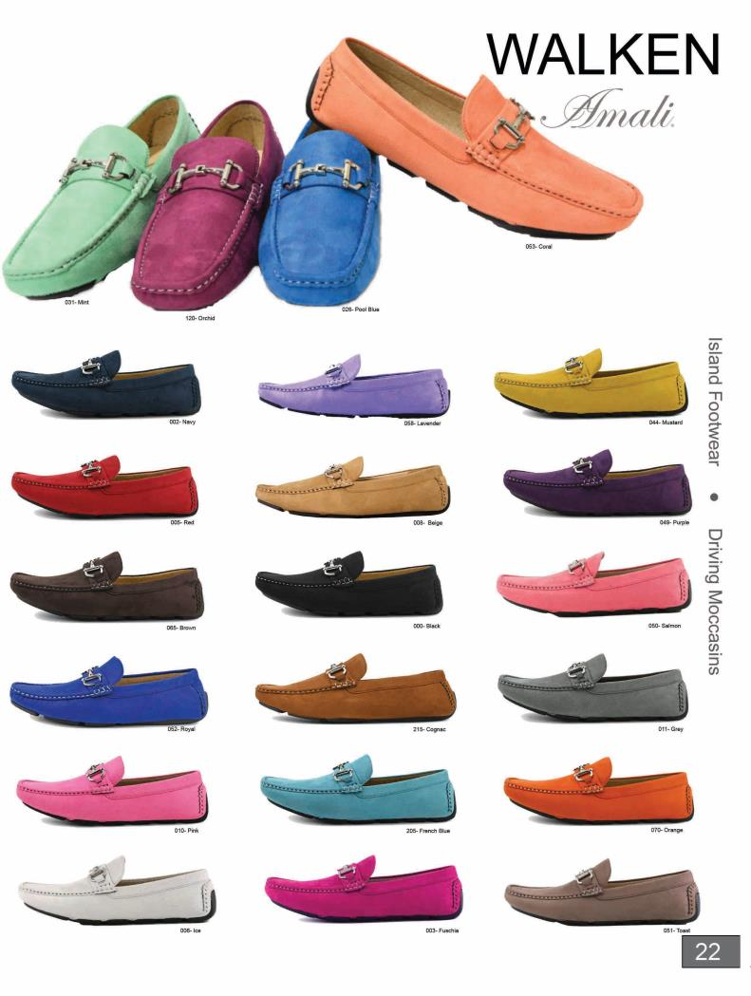

Slide 24
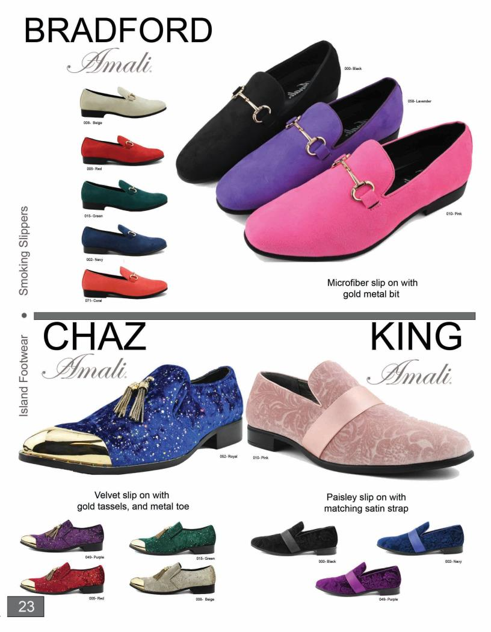

Slide 25
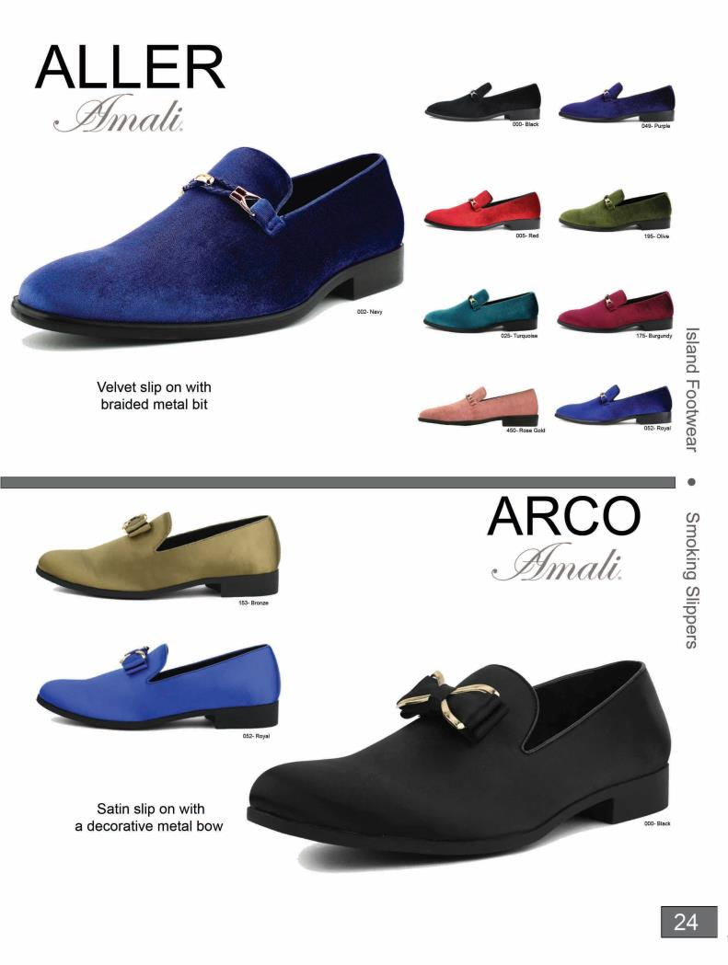

Slide 26
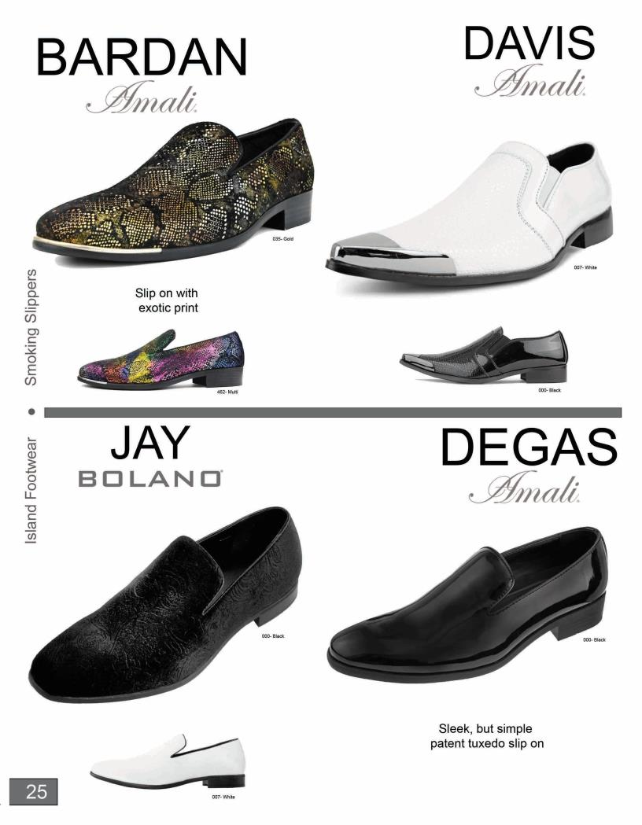

Slide 27
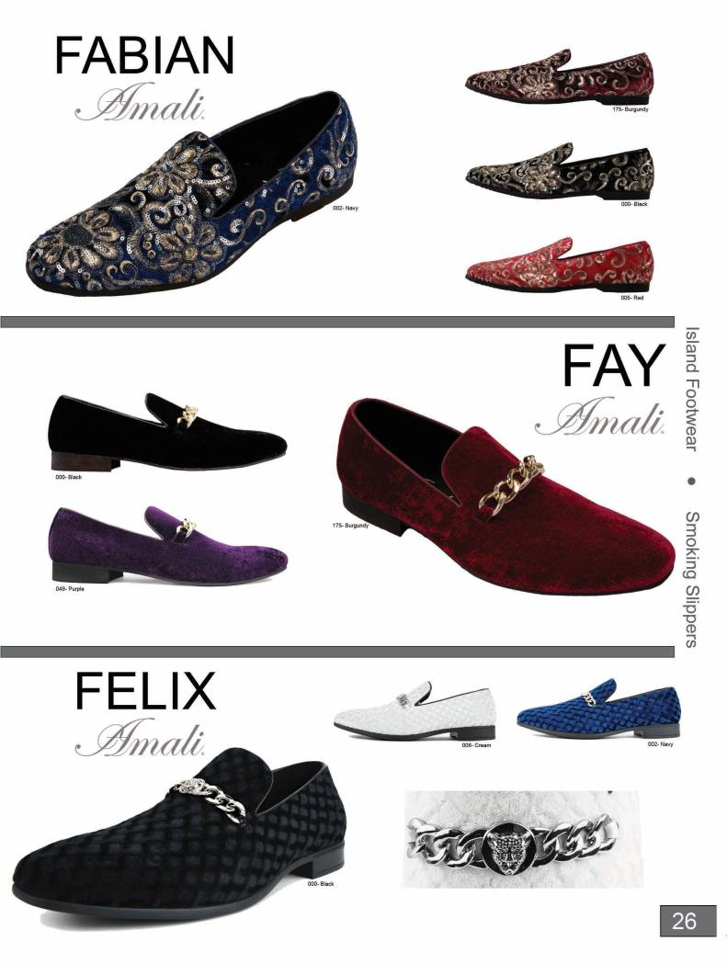

Slide 28
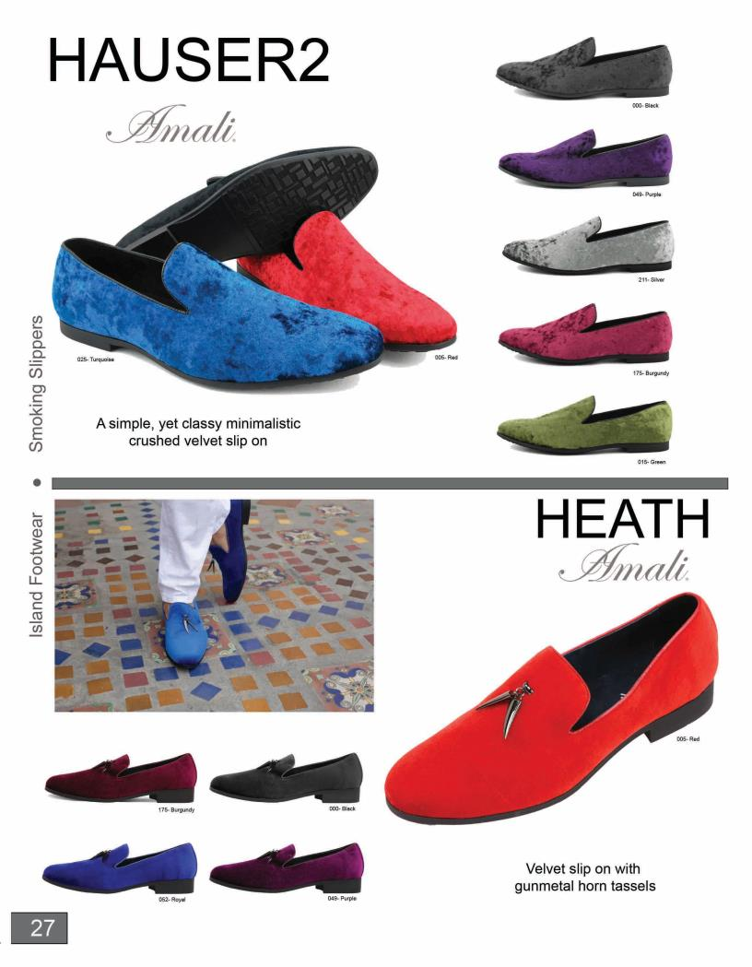

Slide 29
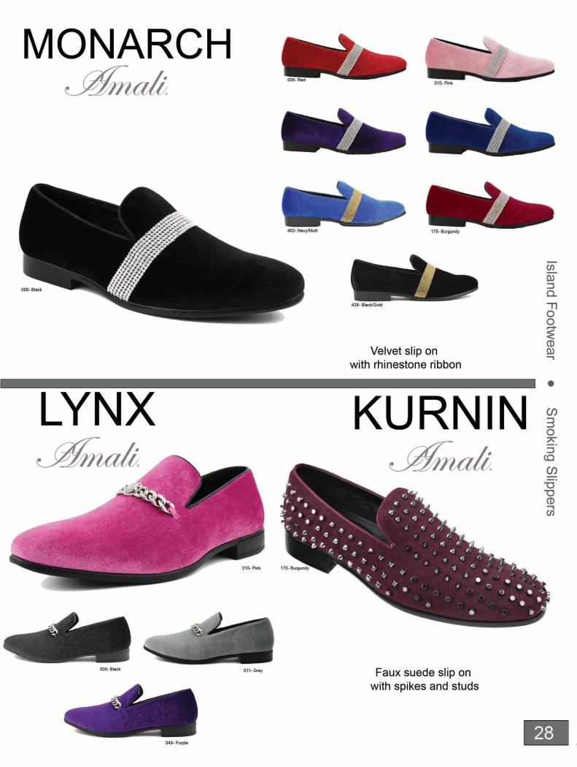

Slide 30
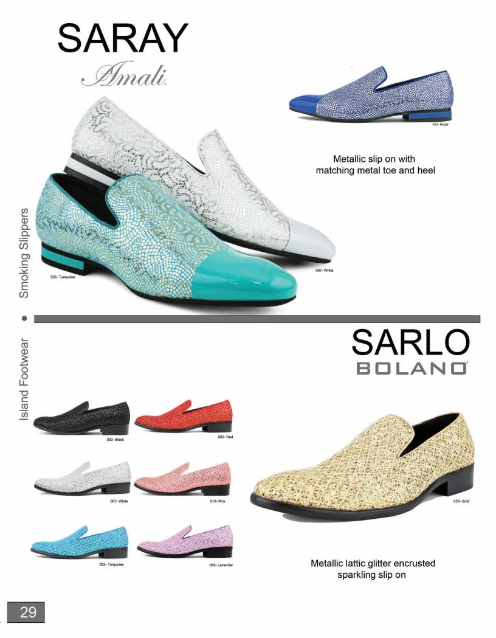

Slide 31
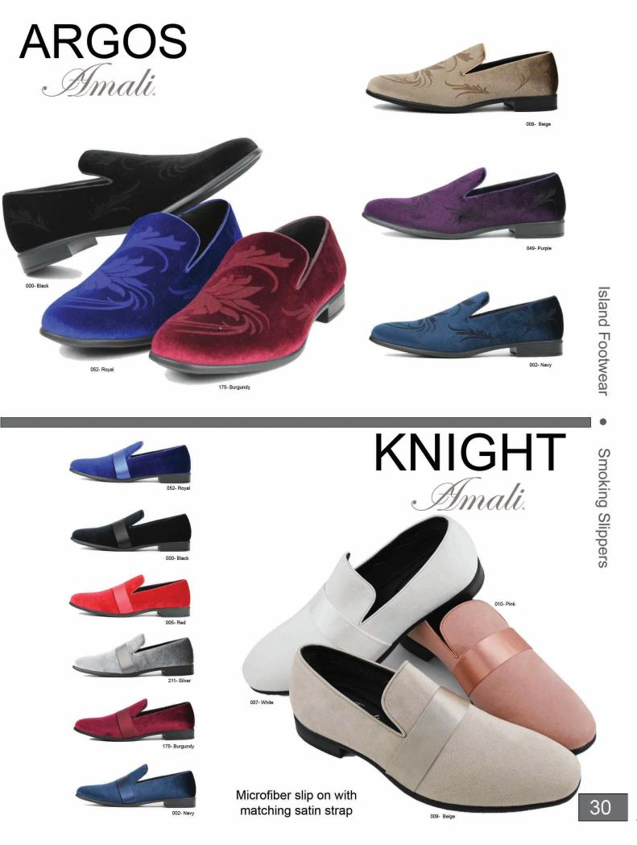

Slide 32
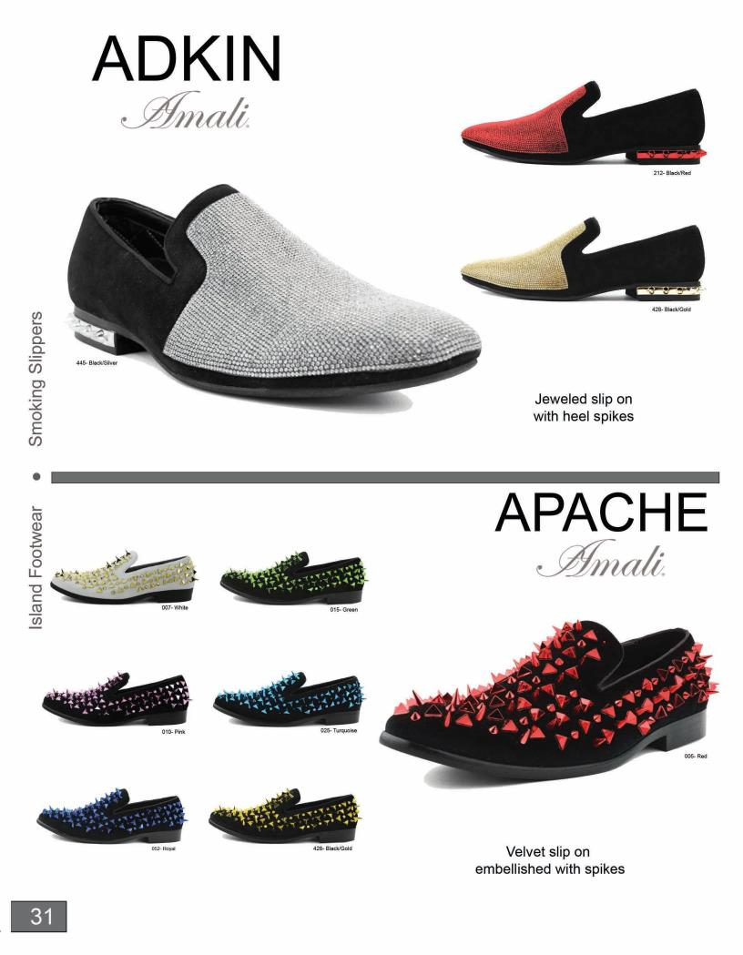

Slide 33
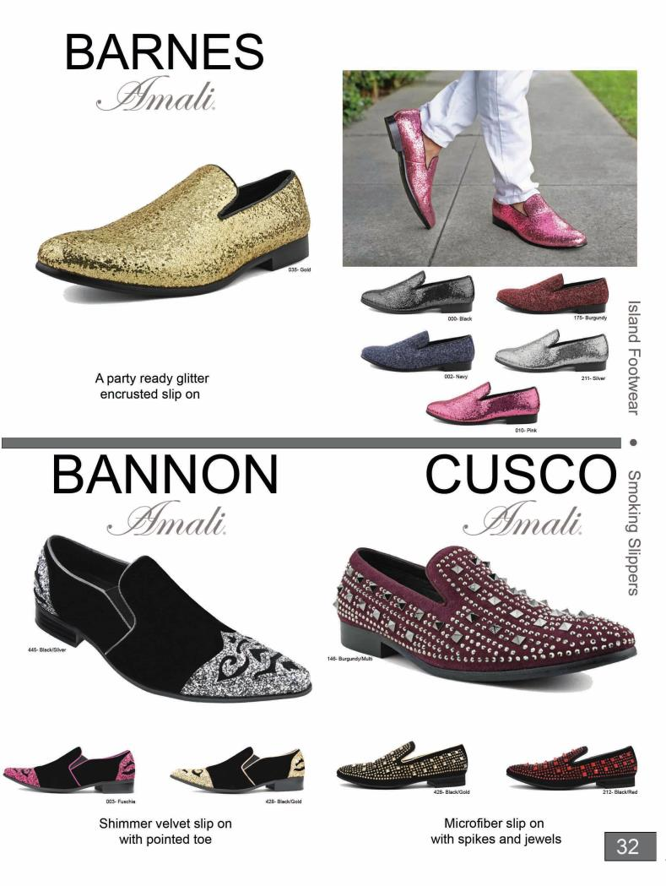

Slide 34
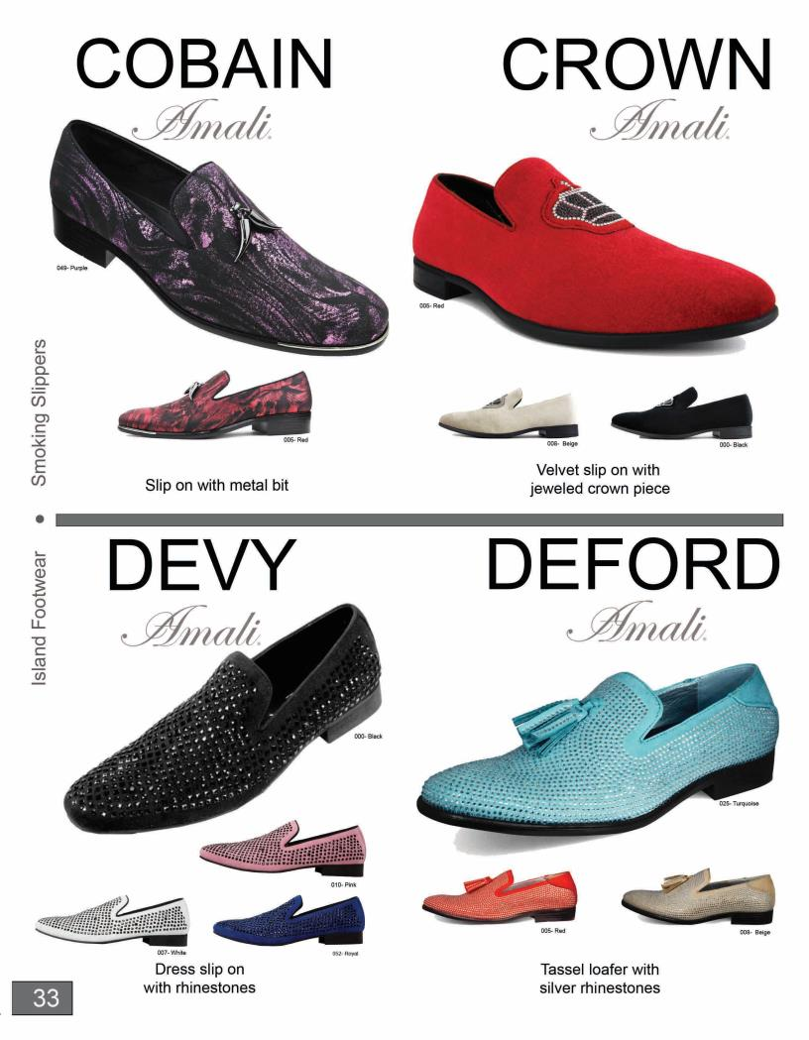

Slide 35
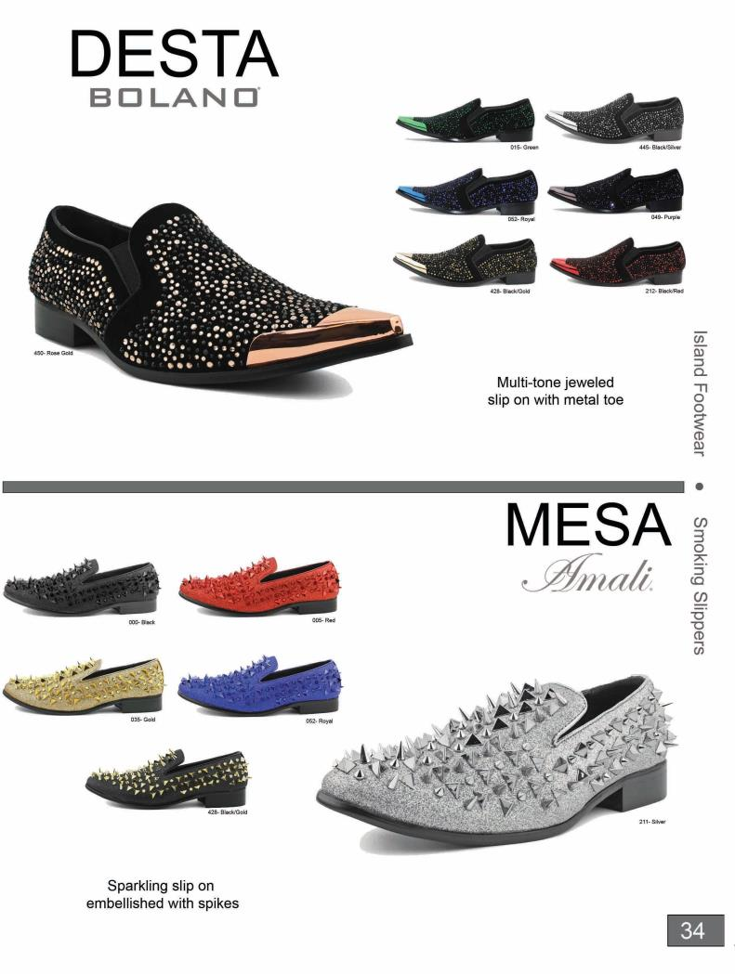

Slide 36
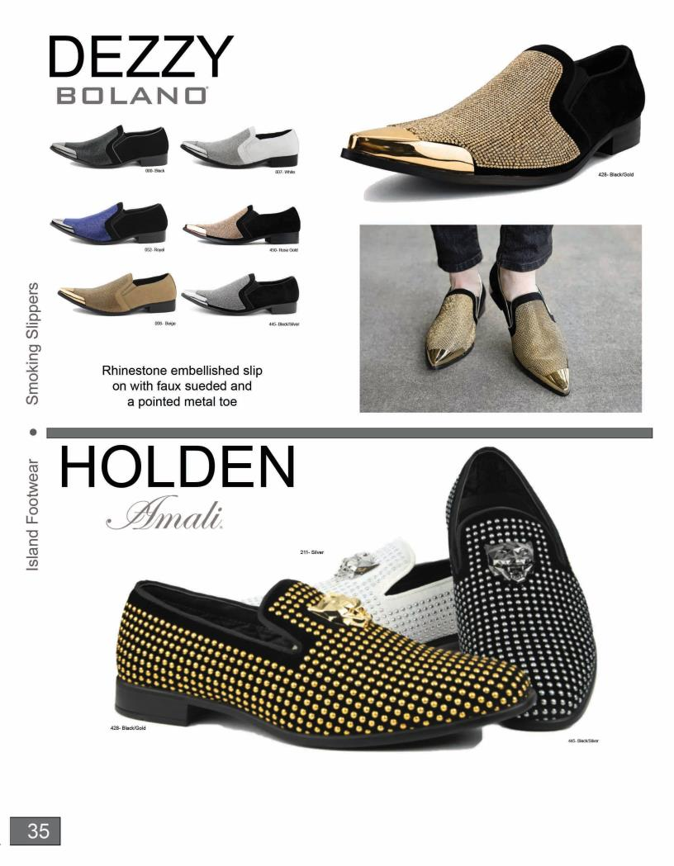

Slide 37
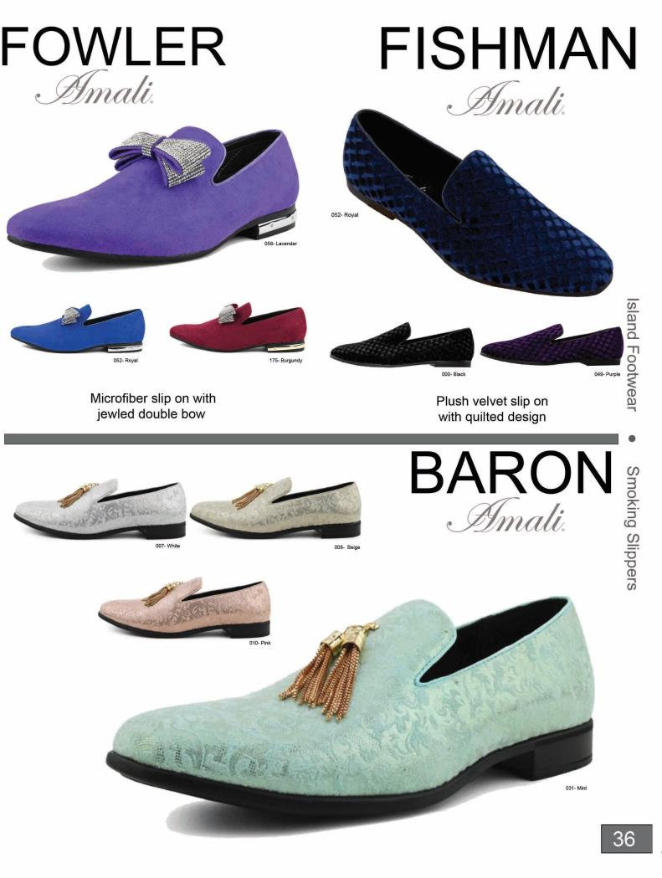

Slide 38
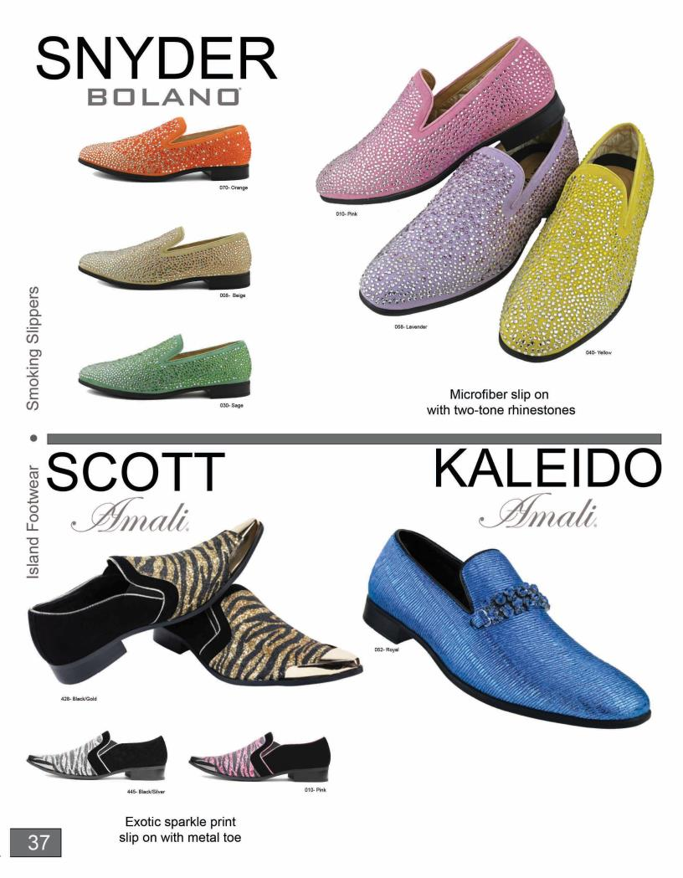

Slide 39
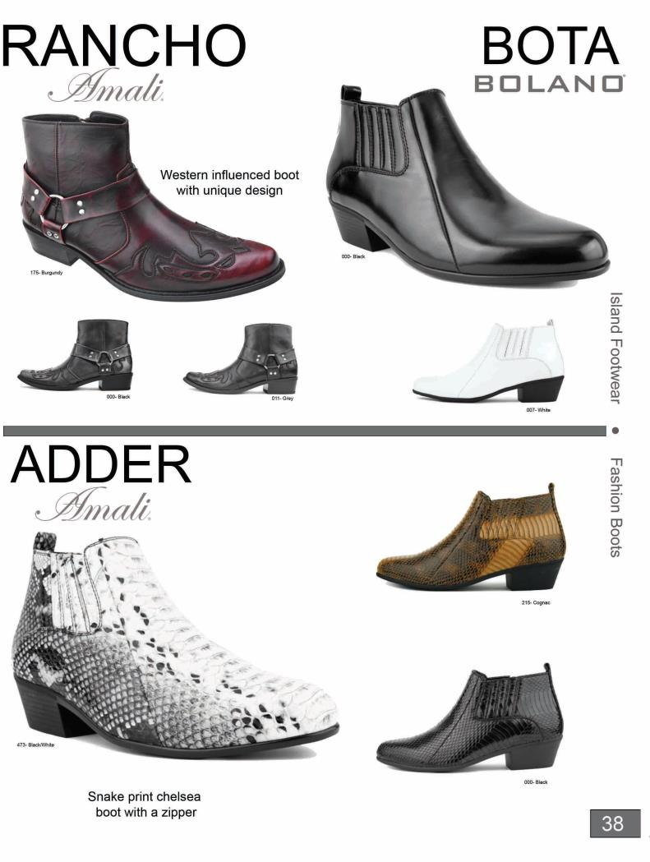

Slide 40
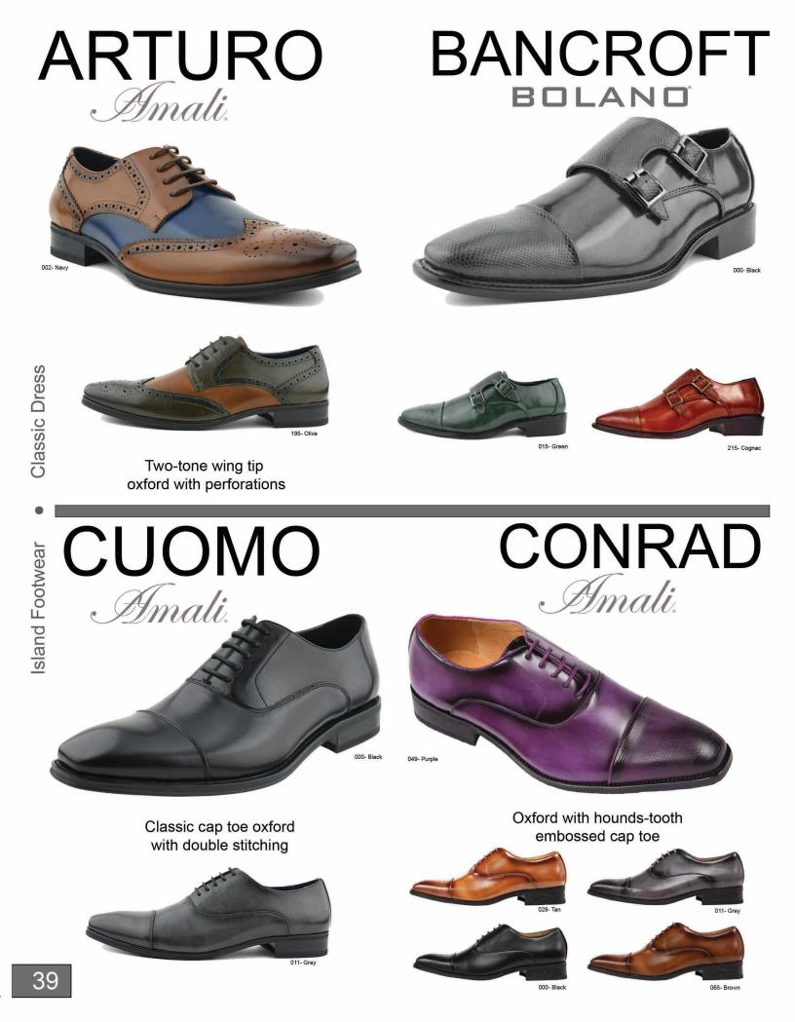

Slide 41
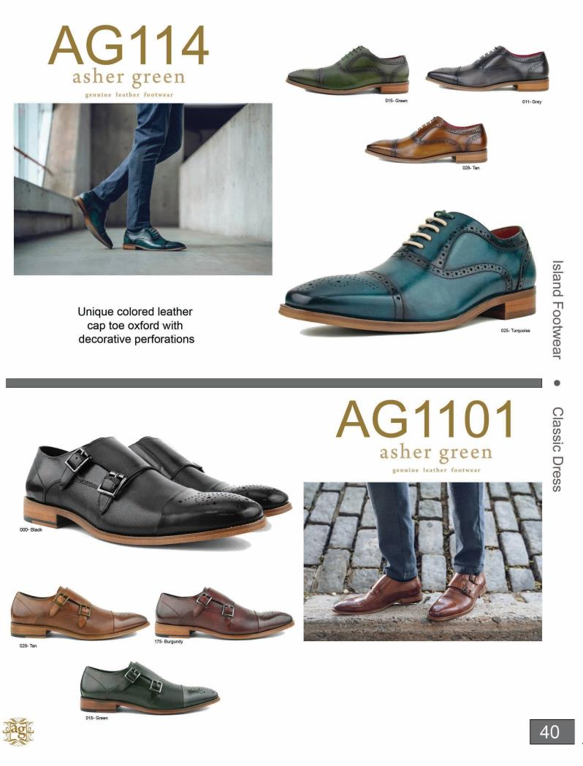

Slide 42
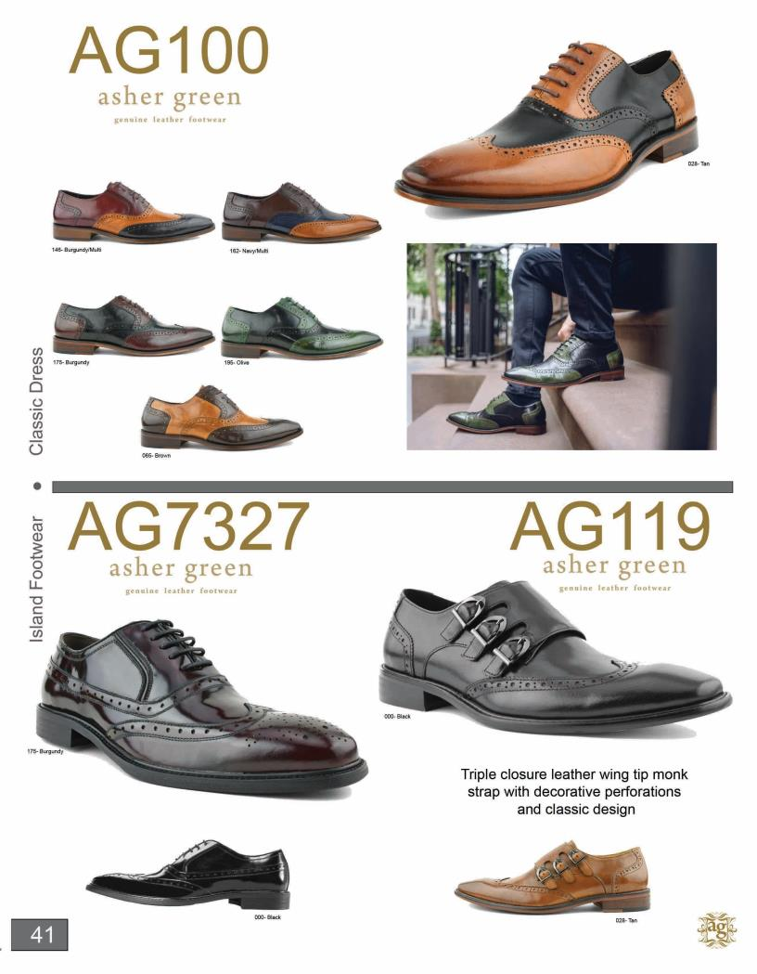

Slide 43
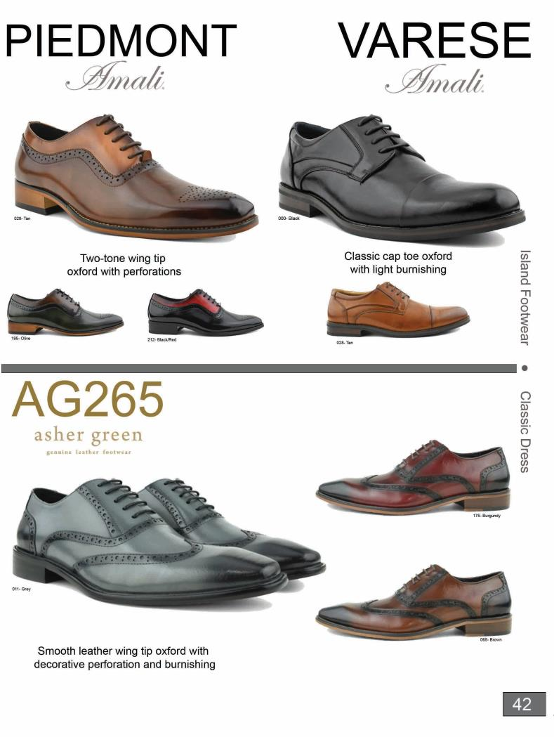

Slide 44
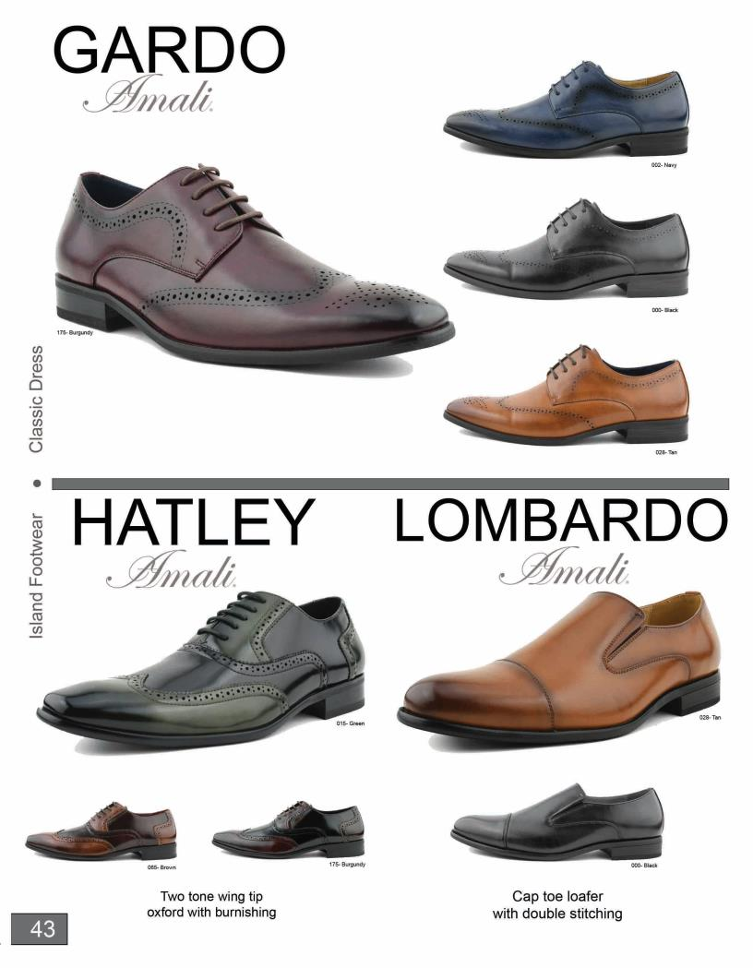

Slide 45
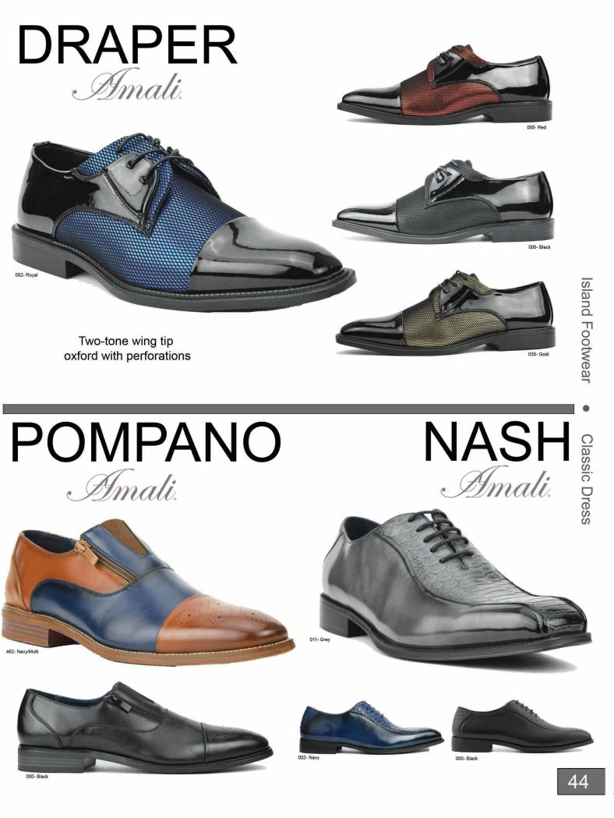

Slide 46
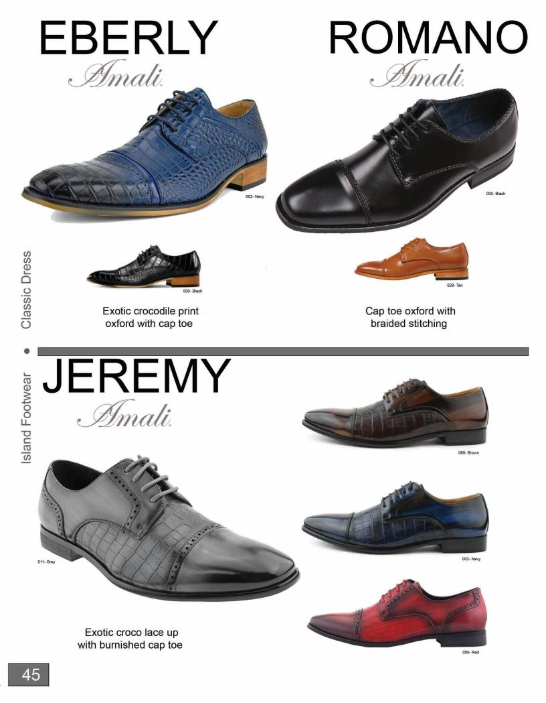

Slide 47
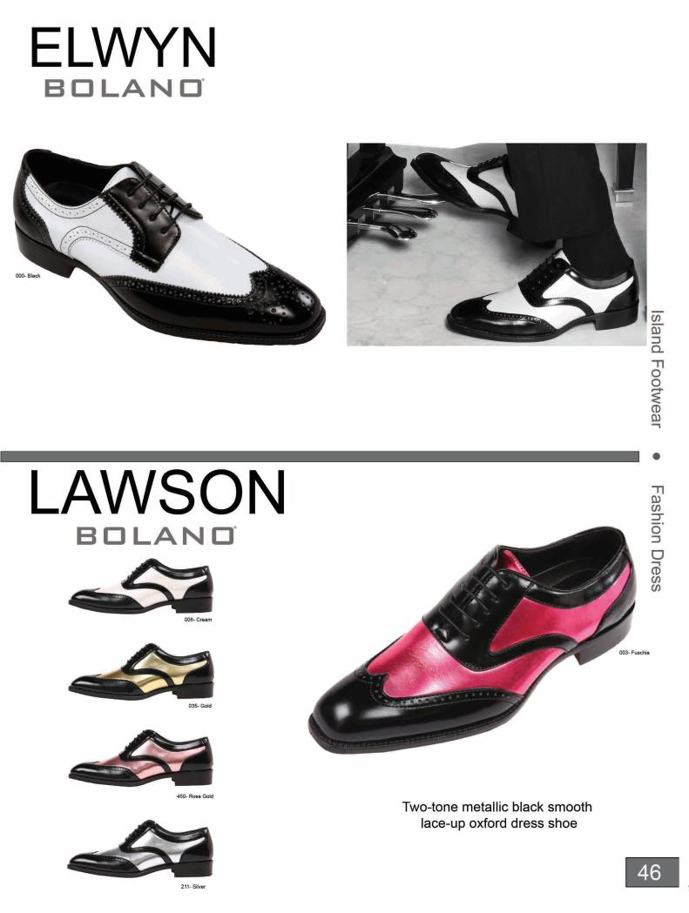

Slide 48
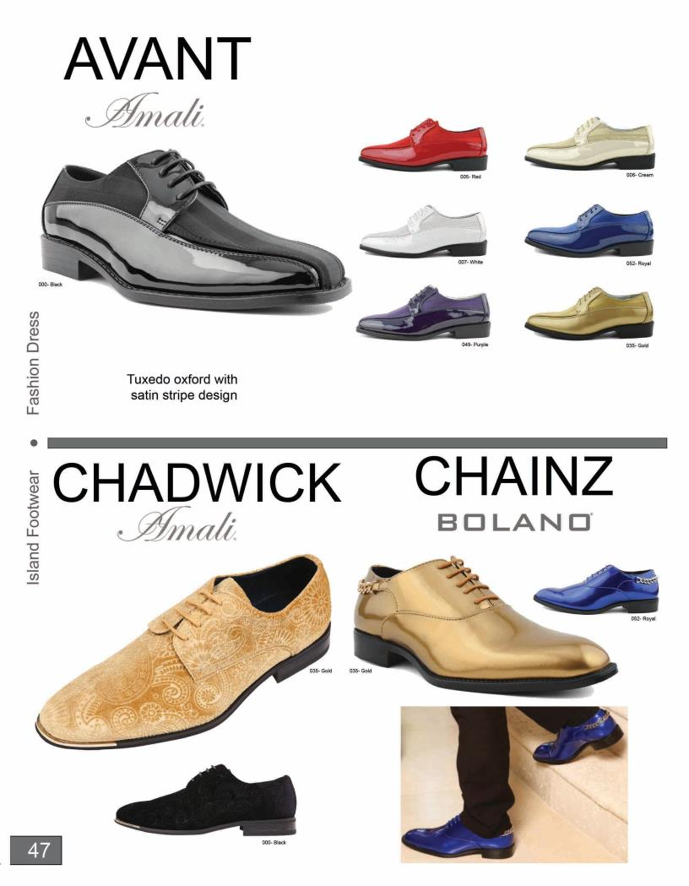

Slide 49
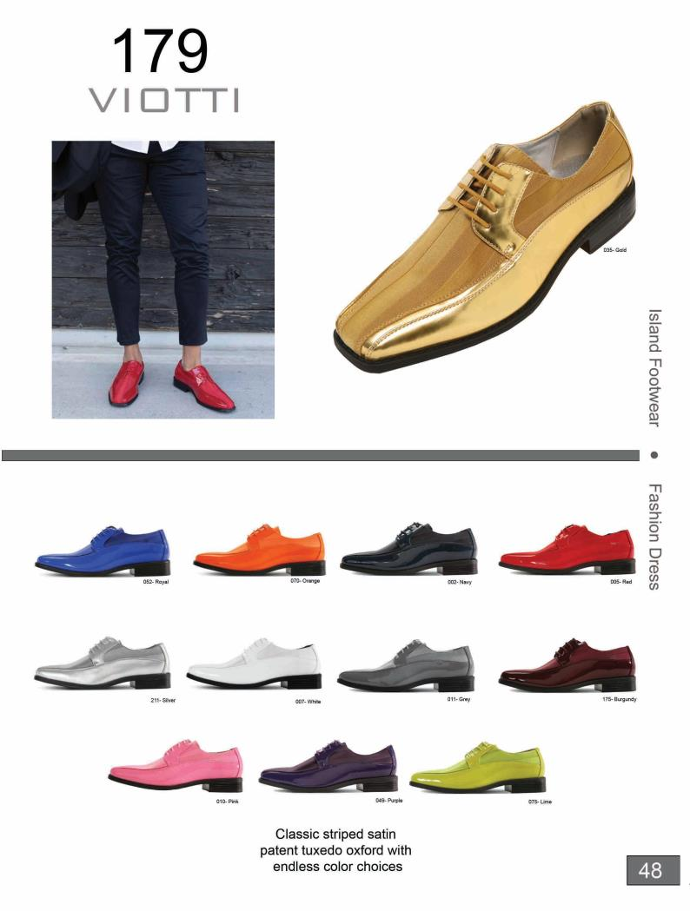

Slide 50
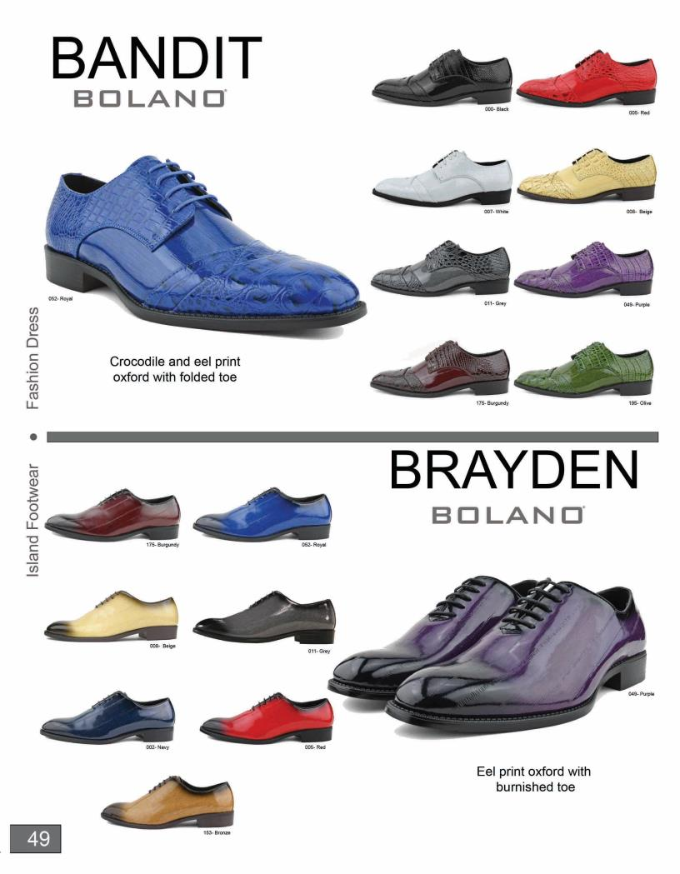

Slide 51
179 | $ 21.95 | Apache | $ 16.95 | Cullen | $ 32.50 | Holden | $ 24.50 | Ril a | $ 16.95
Adder | $ 22.95 | Arco | $ 17.95 | Cuomo | $ 16.95 | Huber | $ 12.95 | Roberto | $ 17.95
Adk in | $ 24.95 | Argos | $ 19.95 | Cusco | $ 12.00 | Jason2 | $ 20.95 | Romano | $ 19.95
AG100 | $ 45.00 | Artem is | $ 24.95 | Daniel | $ 19.95 | Jason2 Low | $ 19.95 | Ryder | $ 29.95
AG1101 | $ 48.00 | Arturo | $ 16.95 | Danny | $ 15.95 | Jason2 Smooth | $ 20.95 | Santos | $ 14.95
AG114 | $ 45.00 | Avant | $ 21.95 | Davis | $ 22.95 | Jay | $ 24.95 | Saray | $ 19.95
AG119 | $ 45.00 | Azur ite | $ 32.50 | Deford | $ 12.95 | Jeremy | $ 19.95 | Sar l o | $ 21.95
AG1822 | $ 50.00 | Bancroft | $ 22.95 | Degas | $ 17.95 | Kansas | $ 27.50 | Sco ria | $ 32.50
AG2023 | $ 50.00 | Band it | $ 19.95 | Desta | $ 32.95 | Ki ng | $ 21.95 | Scott | $ 16.95
AG2632 | $ 50.00 | Bannon | $ 14.95 | Devy | $ 24.95 | Kroy | $ 32.50 | Selenite | $ 32.50
AG265 | $ 35.00 | Bardan | $ 17.95 | Dezzy | $ 32.95 | Lawson | $ 22.95 | Snyder | $ 24.95
AG285 | $ 50.00 | Baron | $ 14.95 | Draper | $ 19.95 | Lombardo | $ 16.95 | Spinel | $ 32.50
AG583 | $ 60.00 | Bota | $ 22.95 | Dysi on | $ 19.95 | M av erick | $ 27.95 | Stark | $ 16.95
AG584 | $ 60.00 | Bradford | $ 21.95 | Eberly | $ 18.95 | Mesa | $ 32.95 | Summer | $ 16.95
AG587 | $ 60.00 | Brayden | $ 19.95 | Ecker | $ 16.95 | Monarch | $ 24.95 | Sunstone | $ 32.50
AG589 | $ 60.00 | Chadwick | $ 19.95 | Faber | $ 32.50 | Monty | $ 16.95 | Titus | $ 17.95
AG6011 | $ 60.00 | Chainz | $ 19.95 | Fa bian | $ 24.95 | Nash | $ 18.95 | Trent ino | $ 17.95
AG6023 | $ 60.00 | Chaz | $ 24.95 | Fay | $ 24.95 | Norvell | $ 16.95 | Trina | $ 16.95
AG6200 | $ 60.00 | Cinnibar | $ 32.50 | Feli x | $ 24.95 | Obsid i an | $ 32.50 | Varese | $ 16.95
AG7327 | $ 35.00 | Clive | $ 20.95 | Fishman | $ 21.95 | Opal | $ 32.50 | Walken | $ 17.95
AG8865 | $ 50.00 | Cobain | $ 14.95 | Garde | $ 16.95 | Pi edmont | $ 16.95 | Zeus | $ 24.95
Aller | $ 21.95 | Cola | $ 16.95 | Hatley | $ 16.95 | Pompano | $ 18.95 | Zircon | $ 32.50
Allesi o | $ 32.50 | Crak le | $ 12.95 | Hauser2 | $ 19.95 | Rancho | $ 22.95 | Zoisite | $ 32.50
Anchor | $ 17.95 | Crown | $ 22.95 | Heath | $ 21.95 | Regan | $ 12.95
Case | 7 | 7.5 | 8 | 8.5 | 9 | 9.5 | 10 | 10.5 | 11 | 12 | 13 | 14 | 15
R • 12 Pack• 7.5-12 |  | 1 | 1 | 1 | 2 | 2 | 2 | 1 | 1 | 1
S • 12 Pack• 8.5-13 |  |  |  | 1 | 1 | 1 | 2 | 2 | 2 | 2 | 1
T • 12 Pack • 9.5-13 |  |  |  |  |  | 1 | 2 | 2 | 2 | 3 | 2
U • 6 Pack• 13-15 |  |  |  |  |  |  |  |  |  |  | 2 | 2 | 2
*For U Run Sizes 13-15 There Is An Additional Charge Of $1.00 Per Pair
Terms and Conditions
•No discounts on any previously made orders, no exceptions
We CANNOT guarantee our shoe colors to match any apparel
•All Group/Special orders are FINAL SALE
•Customer's credit Terms and Conditions are determined by Island Footwear's credit policy
  Prices are subject to change without notice
•Any returns MUST be packed in original boxes. Unreasonable returns may be subject to a 50% restocking fee
No shoes may be returned without written authorization and must be requested within 5 business days upon receipt of goods
•Orders are shipped by UPS GROUND unless advised by a customer otherwise. Customer is liable for any additional shipping charges due to any changes
•Cancellation of orders must be in writing and faxed or emailed to Island Footwear at: (561)-819-0301 or sales@islandfootwear.com
  No discounts for any transportation and/or shipping charges
Unauthorized returns or refusal of shipment from Island Footwear by a customer will be subject to a 25% restocking fee plus any shipping and handling charges
•Open Stock orders are Credit Card Only and Open Stock orders for less than 6 pairs will have a $5 upcharge

